Slide 1

EECS 370 - Lecture 10
FSM and Single-Cycle Datapath
Live Poll + Q&A: slido.com #eecs370
Poll and Q&A Link

Slide 2
Announcements
P2
Two parts: part a is due Thu 2/16
HW 3
Posted on website, due Mon 2/20
Midterm exam Thu March 9, 7-9pm
More details soon
Questions about symbol & relocation tables?
https://eecs370.github.io/#resources

Slide 3
Reminder
D-flip-flops will be the basis of storing bits in this class
Data
D
Q
Clock
q
Q
Latching starts
Value remembered by flip-flop
Latching edge

Slide 4
Finite State Machines
Combine combinational logic and sequential logic
Define a set of "states" that our machine will be in
"Remember" what state we're in using flip-flops
Calculate next-state and output logic using combinational logic
Note: This is very similar to Finite State Autonoma (FSA) from 376, but with a few differences (the input never ends, and the FSM always outputs something)

Slide 5
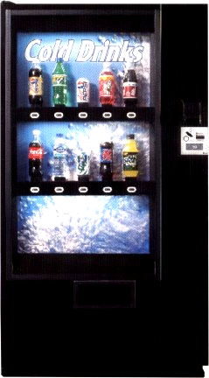
Input and Output
Inputs:
Coin trigger
Refund button
10 drink selectors
10 pressure sensors
Detect if there are still drinks left
Outputs:
10 drink release latches
Coin refund latch

Slide 6
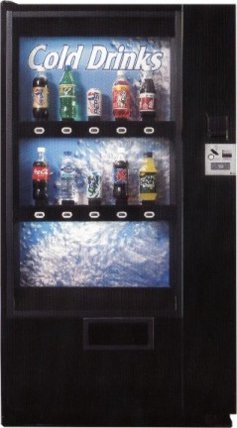
FSM for Vending Machine
Reset
Refund
0 coins
1 coin
Vend drink
Refund
Refund
Refund
3 coins
2 coins
Ran out of specific drink selection
Coin trigger
Refund button
Drink Select
Is this a Mealy or Moore Machine?
This is Mealy: Mealy output is based on current state AND input
Live Poll + Q&A: slido.com #eecs370

Slide 7
Implementing an FSM
Outputs
Implement
transition
functions
(using a ROM and
combinational circuits)
Inputs
Current state
D
Q
Next state
D
Q
2-bit state

Slide 8
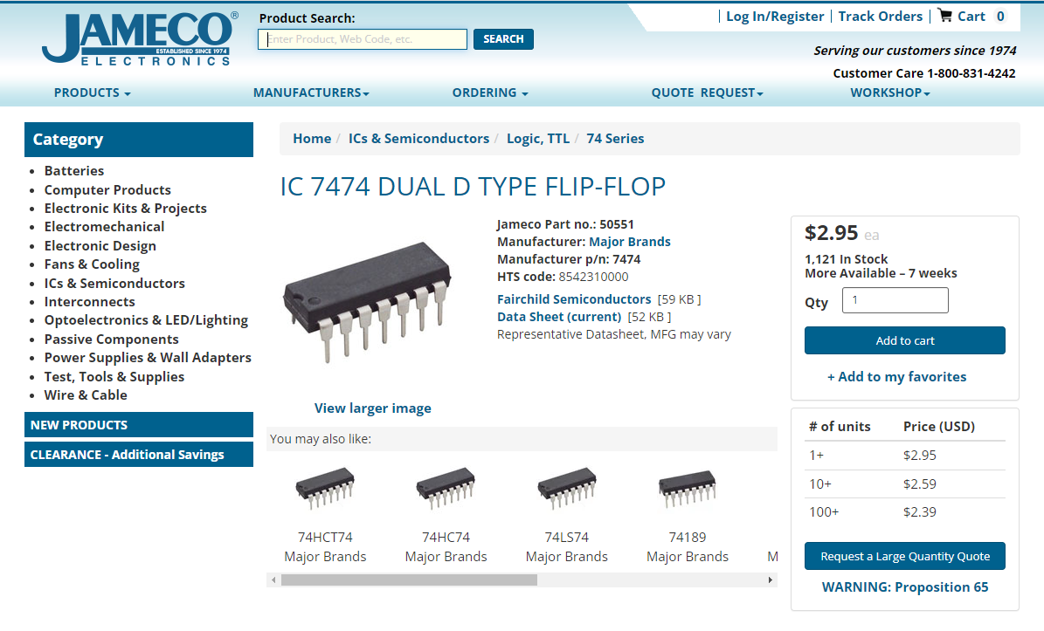
Implementing an FSM
Let's see how cheap we can build this vending machine controller!
Jameco.com sells electronic chips we can use
D-Flip-flops: $3, includes several in one package
For custom combinational circuits, would need to design and send to a fabrication facility
Thousands or millions of dollars!!
Alternative?

Slide 9
Implementing Combinational Logic
A
B
O
C
0
0
0
0
1
1
1
1
0
0
1
1
0
0
1
1
0
1
0
1
0
1
0
1
0
1
0
1
0
1
1
1
If I have a truth table:
I can either implement this using combinational logic:
…or I could literally just store the entire truth table in a memory and just "index" it by treating the input as a number!
Can be implemented cheaply using "Read Only Memories", or "ROMS"
A
B
0
C
{A,B,C}
addr_in
0
1
0
1
0
1
1
1
3
data_out
{O}

Slide 10
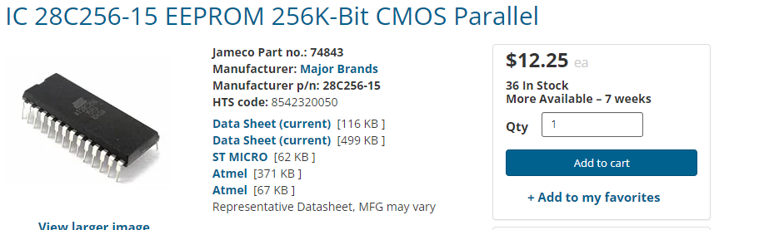
ROMs and PROMs
Read Only Memory (ROM)
Array of memory values that are constant
Non-volatile (doesn’t need constant power to save values)
Programmable Read Only Memory
Array of memory values that can be written exactly once
Electronically Erasable PROM (EEPROM)
Can write to memory, deploy in field
Use special hardware to reset bits if need to update
256 KBs of EEPROM costs ~$10 on Jameco
Much better then spending thousands on design costs unless we're gonna make tons of these

Slide 11
8-entry 4-bit ROM
3x8
Decoder
address
0
1
1
A₀
0
A₁
A₂
3
Reminder: A decoder sets exactly one output high based on input
A diode only allows current to flow in one direction.
It prevents a ‘1’ from propagating to other lines.
7
D₀
1
D₁
0
D₂
0
D₃
1
data

Slide 12
8-entry 4-bit ROM
Input | Output
000
001
010
011
100
101
110
111
3x8
Decoder
address
0
A₀
A₁
A₂
3
7
This ROM corresponds to this truth table
D₃
D₂
D₁
D₀
data

Slide 13
8-entry 4-bit ROM
Poll: What's the formula for size of ROM needed?
Input | Output
000 | 1001
001 | 0100
010 | 0010
011 | 1001
100 | 0010
101 | 0001
110 | 1000
111 | 0000
3x8
Decoder
address
0
A₀
A₁
A₂
3
7
This ROM corresponds to this truth table
D₃
D₂
D₁
D₀
data

Slide 14
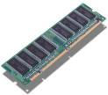
Aside: Other Memories
Static RAM (random access memory)
Built from sequential circuits
Takes 4-6 transistors to store 1 bit
Fast access (< 1 ns access possible)
Dynamic RAM
Built using a single transistor and a capacitor
1’s must be refreshed often to retain value
Slower access than static RAM
Much more dense layout than static RAM
Both require constant power, or they will lose their data (i.e. are volatile)
These will be used to build computer memory hierarchies (later in class)

Slide 15
Implementing Combinational Logic
Custom logic
Pros:
Can optimize the number of gates used
Cons:
Can be expensive / time consuming to make custom logic circuits
Lookup table:
Pros:
Programmable ROMs (Read-Only Memories) are very cheap and can be programmed very quickly
Cons:
Size requirement grows exponentially with number of inputs (adding one just more bit doubles the storage requirements!)

Slide 16



Controller Design So far
What would a ROM for this look like?
Drink Release
Latches
Drink selectors
Big Memory
(24 bit address,
13 bit output)
x10
Pressure Sensors
refund
D Q
Coin release
D Q
coin
Clock/Event
2-bit state

Slide 17
ROM for Vending Machine
Size of ROM is (# of ROM entries * size of each entry)
# of ROM entries = 2^{input_size} = 2²⁴
Size of each entry = output size = 13 bits
We need 2²⁴ entry, 13 bit ROM memories
218,103,808 bits of ROM (26 MB)
Biggest ROM I could find on Jameco was 4 MB @ $6
Need 7 of these at $42??
Let's see if we can do better

Slide 18
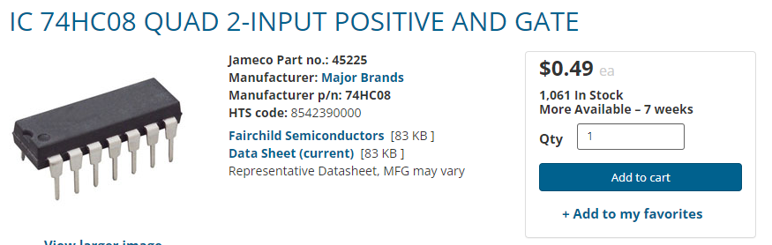
Reducing the ROM needed
Idea: let's do a hybrid between combinational logic and a lookup table
Use basic hardware (AND / OR) gates where we can, and a ROM for everything more complicated
AND / OR gates are mass producible & cheap!
~$0.15 each on Jameco

Slide 19
Reducing the ROM needed
Observation: overall logic doesn't really need to distinguish between which button was pressed
That's only relevant for choosing which latch is released, but overall logic is the same
Replace 10 selector inputs and 10 pressure inputs with a single bit input (drink selected)
Use drink selection input to specify which drink release latch to activate
Only allow trigger if pressure sensor indicates that there is a bottle in that selection. (10 2-bit ANDs)

Slide 20
Putting it all together
Drink selector
Pressure Sensor
Drink Release
10 input
OR gate
32
5×32 decoder
Drink Release
Latches
refund
D Q
Coin release
D Q
coin
Clock/Event
2-bit state

Slide 21
Total cost of our controller
Now:
2 current state bits + 3 input bits (5 bit ROM address)
2 next state bits + 2 control trigger bits (4 bit memory)
2⁵ × 4 = 128 bit ROM
1-millionth size of our 26 MB ROM😬
Total cost on Jameco:
Flip-flops to store state: $3
ROM to implement logic: $3
AND/OR gates: $5
Total: $11
Could probably do a lot cheaper if we buy in bulk

Slide 22
Can we design LC2K Processor as FSM?
Outputs
Implement
transition
functions
(using a ROM and
combinatorial circuits)
Inputs
Current state
We need a more ad-hoc way of designing our processor
But FSMs will be used!
Memory
Next state
Register
file
65,536 × 32 + 9 × 32 bits
65,536 × 32 + 9 × 32 bits
Far more states than atoms
in the Universe!

Slide 23
Single-Cycle Processor Design
General-Purpose Processor Design
Fetch Instructions
Decode Instructions
Instructions are input to control ROM
ROM data controls movement of data
Incrementing PC, reading registers, ALU control
Clock drives it all
Single-cycle datapath: Each instruction completes in one clock cycle

Slide 24
LC2K Datapath Implementation
1
+
+
15-0
Sign extend
M
U
X
Instruction
memory
21-19
Register
file
Data
memory
PC
Instruction bits
18-16
M
U
X
A
L
U
M
U
X
M
U
X
18-16
2-0
En
En
R/W
24-22
Control ROM
3x8
decoder
‹#›/39
‹#›

Slide 25
Building Blocks for the LC2K
Control
memory
memory
Register
file
reg
M
U
X
M
U
X
M
U
X
M
U
X
3to8
ROM
State
A
L
U
Very easy!
Just a few wires
Compute
+
+
Sign extend
Here are the pieces, go build yourself a processor!

Slide 26
Control Building Blocks (1)
Connect one of the inputs
to OUT based on the value
of select
2 to 1 MUX
IN1
M
U
X
OUT
IN2
If (! select)
OUT = IN1
Else
OUT = IN2
select

Slide 27
Control Building Blocks (2)
Decoder activates one of the
output lines based on the input
3 to 8 decoder
OUT 7:0
IN OUT
210 76543210
000 00000001
001 00000010
010 00000100
011 00001000
etc.
IN2
IN1
3x8 decoder
IN0
Read-only Memory
Addr
ROM
Data
ROM stores preset data in each location
Give address, get data.

Slide 28
Compute Building Blocks (1)
Perform basic arithmetic
functions
Arithmetic Logic Unit
EQ
OUT = f(IN1, IN2)
EQ = (IN1 == IN2)
For LC2K:
f=0 is add
f=1 is nor
For other processors, there
are many more functions.
IN1
A
L
U
OUT
IN2
function
Adder
IN1
+
OUT
Just adds
IN2

Slide 29
Compute Building Blocks (2)
Sign extend (SE) input by
replicating the MSB to
width of output
Sign Extension Unit
OUT(31:0) = SE(IN(15:0))
OUT(31:16) = IN(15)
OUT(15:0) = IN(15:0)
IN
Sign extend
OUT
Useful when compute unit is wider than data

Slide 30
State Building Blocks (1)
Small/fast memory to store
temporary values
n entries (LC2 = 8)
r read ports (LC2 = 2)
w write ports (LC2 = 1)
Register File or Register
R1
Register
file
R2
OUT1
W
OUT2
* Ri specifies register
number to read
* W specifies register
number to write
* D specifies data to write
D
reg
write enable
Poll: How many bits are Ri and W in LC2K?

Slide 31
State Building Blocks (2)
Memory
Slower storage structure
to hold large amounts of
stuff.
Use 2 memories for LC2K
* Instructions
* Data
* 65,536 total words
Memory
Addr
DataOut
DataIn
En
R/W

Slide 32
Recap: LC2K Instruction Formats
Tells you which bit positions mean what
R type instructions (add ‘000’, nor ‘001’)
I type instructions (lw ‘010’, sw ‘011’, beq ‘100’)
31-25
24-22
21-19
18-16
15-3
2-0
unused
opcode
regA
regB
unused
destR
31-25
24-22
21-19
18-16
15-0
unused
opcode
regA
regB
offset

Slide 33
LC2K Datapath Implementation
1
+
+
15-0
Sign extend
M
U
X
Instruction
memory
21-19
Register
file
Data
memory
PC
Instruction bits
18-16
M
U
X
A
L
U
M
U
X
M
U
X
18-16
2-0
En
En
R/W
24-22
Control ROM
3x8
decoder
‹#›/39

Slide 34
Executing an ADD Instruction
1
+
+
15-0
Sign extend
M
U
X
Instruction
memory
21-19
Register
file
Data
memory
PC
Instruction bits
18-16
M
U
X
A
L
U
M
U
X
M
U
X
18-16
2-0
En
En
R/W
add regA, regB, destR
destR = regA + regB
PC = PC + 1
24-22
Control ROM
3x8
decoder
‹#›/39

Slide 35
Executing an ADD Instruction on LC2K Datapath
1
+
+
Sign extend
M
U
X
Instruction
memory
0 0 1
Register
file
Data
memory
PC
0 1 0
M
U
X
A
L
U
0 1 1
M
U
X
M
U
X
En
En
R/W
0 0 0
add 1 2 3
3x8
decoder
1
1
1
1
0
0
❒
‹#›/39

Slide 36

Next Time
Finish up single-cycle and talk about multi-cycle
Lingering questions / feedback? I'll include an anonymous form at the end of every lecture: https://bit.ly/3oXr4Ah
Live Poll + Q&A: slido.com #eecs370

Slide 37
Executing a NOR Instruction
Poll: Which control bits need to be different from ADD?
1
+
15-0
+
Sign extend
M
U
X
Instruction
memory
21-19
Register
file
Data
memory
PC
Instruction bits
18-16
M
U
X
A
L
U
M
U
X
M
U
X
18-16
2-0
En
En
R/W
nor regA, regB, destR
destR = ~(regA | regB)
PC = PC + 1
24-22
Control ROM
3x8
decoder
A
B
C
D
E
F
G
‹#›/26

Slide 38
Executing NOR Instruction on LC2K
1
+
+
Sign extend
M
U
X
Instruction
memory
0 0 1
Register
file
Data
memory
PC
0 1 0
M
U
X
A
L
U
0 1 1
M
U
X
M
U
X
En
En
R/W
0 0 1
nor 1 2 3
3x8
decoder
1
1
1
1
1
0
❒
‹#›/26

Slide 39
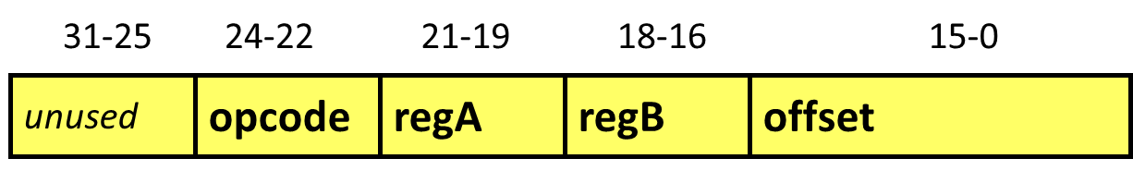
Executing a LW Instruction
Poll: Which control bits need to be different from ADD?
1
+
15-0
+
Sign extend
M
U
X
Instruction
memory
21-19
Register
file
Data
memory
PC
Instruction bits
18-16
M
U
X
A
L
U
M
U
X
M
U
X
18-16
2-0
En
En
R/W
24-22
lw regA, regB, offset
regB = M[regA+offset]
PC = PC + 1
Control ROM
3x8
decoder
A
B
C
D
E
F
G
‹#›/26
‹#›/26

Slide 40
Executing a LW Instruction on LC2Kx Datapath
1
+
0…011001
+
Sign extend
M
U
X
Instruction
memory
0 0 1
Register
file
Data
memory
PC
M
U
X
A
L
U
0 1 0
M
U
X
M
U
X
En
En
R/W
0 1 0
lw 1 2 25
3x8
decoder
0
0
1
0
0
1
0
‹#›/26

Slide 41
Executing a SW Instruction
Poll: Which control bits need to be different from LW?
1
+
15-0
+
Sign extend
M
U
X
Instruction
memory
21-19
Register
file
Data
memory
PC
Instruction bits
18-16
M
U
X
A
L
U
M
U
X
M
U
X
18-16
2-0
En
En
R/W
sw regA, regB, offset
M[regA+offset] = regB
PC = PC + 1
24-22
Control ROM
3x8
decoder
A
B
C
D
E
F
G
‹#›/26
‹#›/26
‹#›/26
‹#›

Slide 42
Executing a SW Instruction on LC2Kx Datapath
1
+
0…011001
+
Sign extend
M
U
X
Instruction
memory
0 0 1
Register
file
Data
memory
PC
0 1 0
M
U
X
A
L
U
M
U
X
M
U
X
En
En
R/W
0 1 1
sw 1 2 25
3x8
decoder
❒
❒
0
0
0
1
1
‹#›/26

